Slide 1

JSPM's Imperial College of Engineering and Research, Wagholi High Speed Data Communication using LiFi Providing Security Guided by: Prof. A. Bharate Presented by: Nadeem Patil Hemant Badhe Pramodini Akhade Abhijeet Jirole

Slide 2
Index terms
Introduction
Motivation
Literature review
Objectives
Existing System
Proposed System
System Architecture
Mathematical Model
Flow of execution
UML Diagram
Conclusion
References
Publication

Slide 3
Introduction
WiFi.
LiFi (Light Fidelity).
VLC (Visible Light Communication).
LEDs (Light Emitting Diodes).
Photo Diodes

Slide 4
Motivation
Increasing number of Network and Data usage.
Bandwidth limitations of existing systems.
Lack of presence of transmission medias in restricted areas.
Restriction of wireless medias in Hospitals.

Slide 5
Literature Survey
Sr. No. | IEEE Paper | Year | Findings
1. | LiFi – The path to a New Way of Communication | 2017 | This paper summarizes most of the research , developments and application achieved so far and looks at the different aspects of the strengths and weaknesses.
2. | High Sensitivity LiFi receiver for enhanced Data Communication | 2016 | Visible light acts as rival to the present wireless radio frequency communication by larger bandwidth and high data rate.
3. | "Integrated LiFi (Light Fidelity) for smart communication through illumi- nation | 2016 | The intensity of the LEDs is varied by alternating the current passed through them at very high speeds. However, the human eye cannot recognize this change and the LEDs appear to have a constant intensity.

Slide 6
Literature Survey
Sr. No. | IEEE Paper | Year | Findings
4. | LiFi: Conceptions, misconceptions and opportunities" | 2016 | Explains what Light Fidelity is and highlights the key differences to visible light communication.
5. | Future internet and Internet of things | 2017 | The future Internet will be capable of connecting and communicating with almost all physical and virtual objects around us to the existing Internet. The Internet of Things is a vision that entails connectivity among different physical and virtual objects in order to understand how the life would change when things, homes and cities become smart.
6. | "Prototyping and measurements for a LiFi system |  | Provides brief information about Prototyping and measurements used for LiFi system.

Slide 7
Objectives
To provide better data transmission technologies to the Modern Computing devices.
High Speed.
To Manage LiFi Powered Devices.
Provide LiFi to Mobile and Stationary Computing Devices.

Slide 8
Existing Systems
LiFi as a broadcasting service
WiFi
Bluetooth
WiMax
Infrared

Slide 9
Limitations of Existing System
No Data Transmission Security.
One Way Communication.
No Data Synchronisation.
No full control over data transmission.

Slide 10
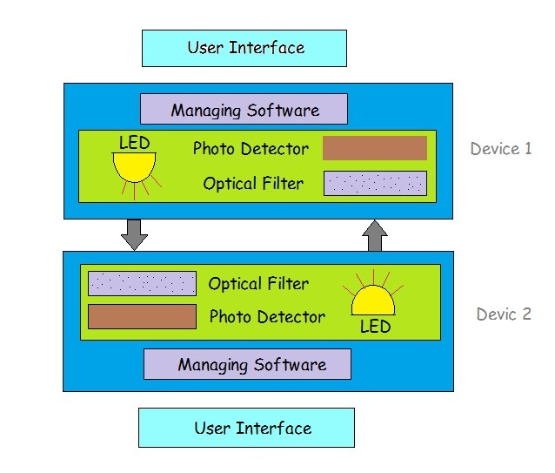
Proposed system

Slide 11
Mathematical Model
System Description:
S = {I, O, F, Sc }
Where,
I= Input from the user in text format or input as a file
O= Given text or a file at receiver side
F= Failure condition
Sc= Success condition

Slide 12
Flow of Execution
Software Startup
File selection
Hardware initialisation
Data Transmission
Device termination

Slide 13
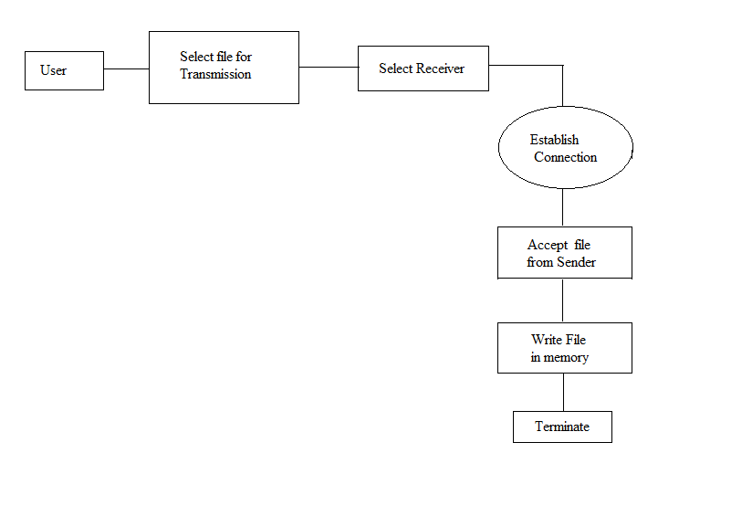
UML Diagram(Data Flow)

Slide 14
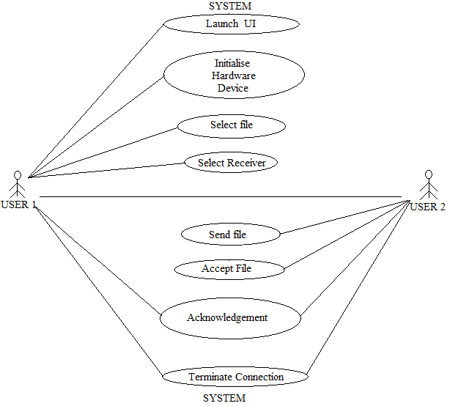
UML Diagram(Use Case)

Slide 15
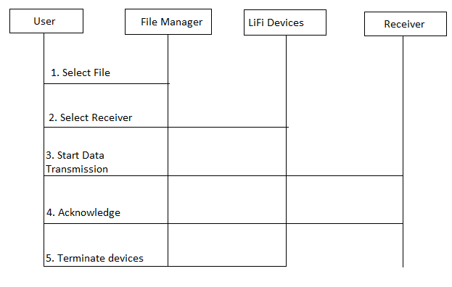
UML Diagram(Sequence Diagram)

Slide 16
Conclusion
As the electromagnetic spectrum becomes continuously overcrowded, the LiFi technology promises to provide a faster, safer, greener, better and healthier future for wireless communication system.

Slide 17
References
[1] Zashi P. Chaudhari, Satish R. Devane, ”High sensitivity universal LiFi receiver for enhanced data communication”, IEEE, 2016.
[2] Monica Leba, Simona Riurean, Andreea Lonica, ”LiFi The path to a New Way of Communication”, IEEE, 2017.
[3] Authors:R. Mahendran, ”Integrated LiFi (Light Fidelity) for smart communication through illumination”, IEEE, 2016.
[4] Harald Hass, ”LiFi: Conceptions, misconceptions and opportunities”, IEEE, 2016.

Slide 18
References
[5] Pradeep Kumar, ”Future internet and Internet of things”, IEEE, 2017.
[6] Kun Chen Hu, ”Prototyping and measurements for a LiFi system”, IEEE, 2016.
[7] Dahmani Mohammed, ”Digital data transmission via visible light communication(VLC): Applica- tion
vehicle to vehicle communication”, IEEE, 2016.
[8] Wasiu O. Popoola, ”Impact of VLC on Light Immission Quality of White LEDs”, IEEE, 2016.
[9] Wasiu O.Popoola, ”On visible light communication and quality of light emitted from illumi- nation LEDs”, IEEE, 2016.

Slide 19
Publication
Submitted for IJCA January 2018 edition.
Paper Title: High Speed Data Communication Using LiFi Providing Security
Paper Reference ID: N/A

Slide 20
Thank You!

